Slide 1
3D Design Consultation Service Delivery-
How to Interact with CC3D
Copyright 2019- Collins Creations 3D Ltd.

Slide 2
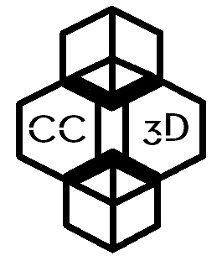
Design Consultation Service Delivery-
How to interact with CC3D
*Please see the 3D Scanning Flowchart and 3D Printing Service Flowchart for further details on how these services can be provided to you or your business.
Upon closing the first meeting, the CC3D representative will formulate solutions to clients needs and requests that would benefit from 3D Printing or 3D Scanning technologies, and to see how these could be applied most effectively to address the clients stated needs
First consultation meeting to discuss in depth client goals and aims and how CC3D can assist with developing their product. Signing of NDAs can be undertaken here.
Client problem/query stated in direct message from website
Send message to CC3D from website
Book a meeting location and time based upon clients needs and preferences. Discuss Fees.
CC3D
Telephone, email or face to face interaction to discuss outline of problem and possible CC3D service requirements
Use website for initial guidance
Indirect Contact with CC3D
Analysis of client queries, designs, blueprints and business specific requirements will be performed to formulate a quote based on assistance needed, including 3D Scanning Services, 3D Printing Services, CAD requirements and Design Consultation time required.
Direct Contact with CC3D
Relay preliminary quote to client(s)
Deliver product via mail service/ digitally
Personal delivery of product with CC3D staff member
If client is happy to proceed then CC3D will progress to initiate all services requested by the clients including any of the following: Design Consultation Services, 3D Printing Services and 3D Scanning as agreed upon in any and all contracts signed between CC3D and the client.*
Provide feedback to CC3D
Provide feedback to CC3D
Upon conclusion of the contract between CC3D and client, we shall deliver products created by CC3D either in digital format or as 3D printed models to the specific requirements of the client. These product(s) can be sent by email in digital format or if a face to face client based in Cornwall requests that their product(s) be delivered by CC3D in person, this can be arranged. If the product(s) manufactured by CC3D are 3D printed models we can send these by registered mail or if a face to face client based in Cornwall requests that their product(s) be delivered by CC3D in person, this can be arranged.

