Slide 1
3D Printing
Service Delivery-
How to Interact with CC3D
Copyright 2019- Collins Creations 3D Ltd.

Slide 2
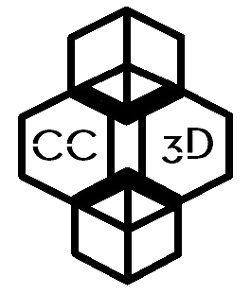
Indirect Contact with CC3D
3D Printing
Service Delivery-
How to interact with CC3D
Direct Contact with CC3D
Follow website instructions
Telephone, email or face to face interaction
Upload and fill out Order Form
Arrange Design Consultation meeting and preliminary quote*
Send Order Form to CC3D
At meeting outline project details and planning
CC3D Printing Hub
Produce 3D model, save to portable device
Analyse 3D model for compatibility
* Please see Consultation Flowchart for further details
Assess project requirement and produce quote
Relay final quote to client(s)
3D print order to requested specifications
Deliver product via mail service/ digitally
Personal delivery of product with CC3D staff member
Provide feedback to CC3D

